Slide 1


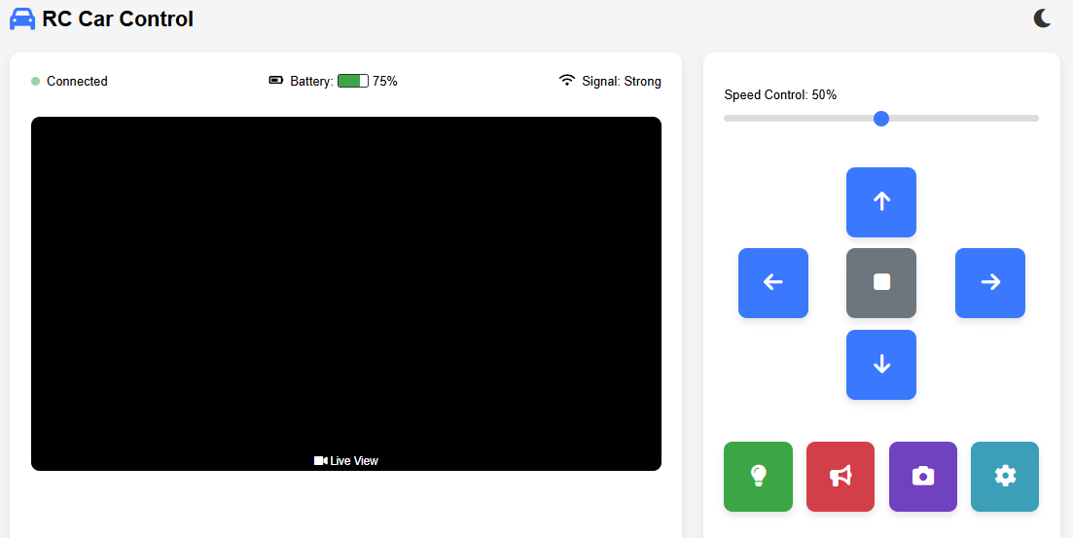
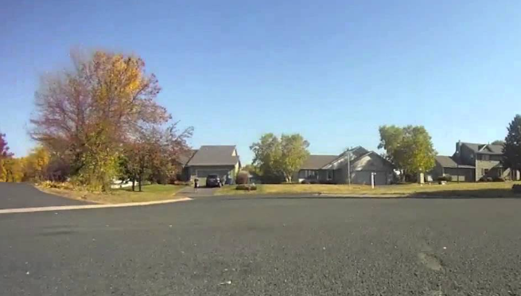
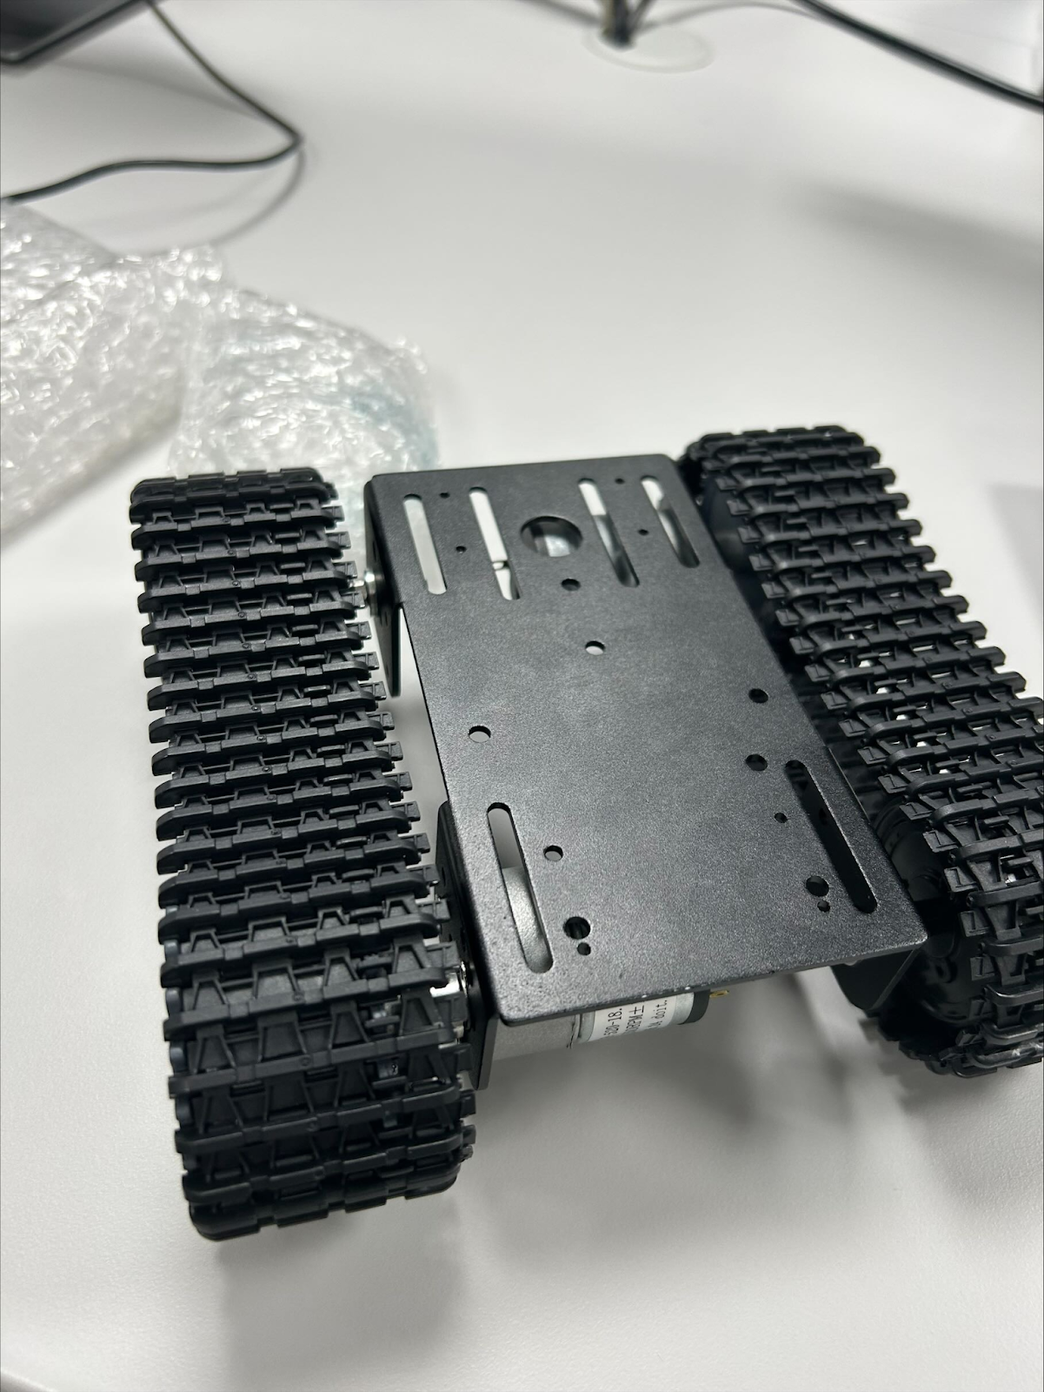

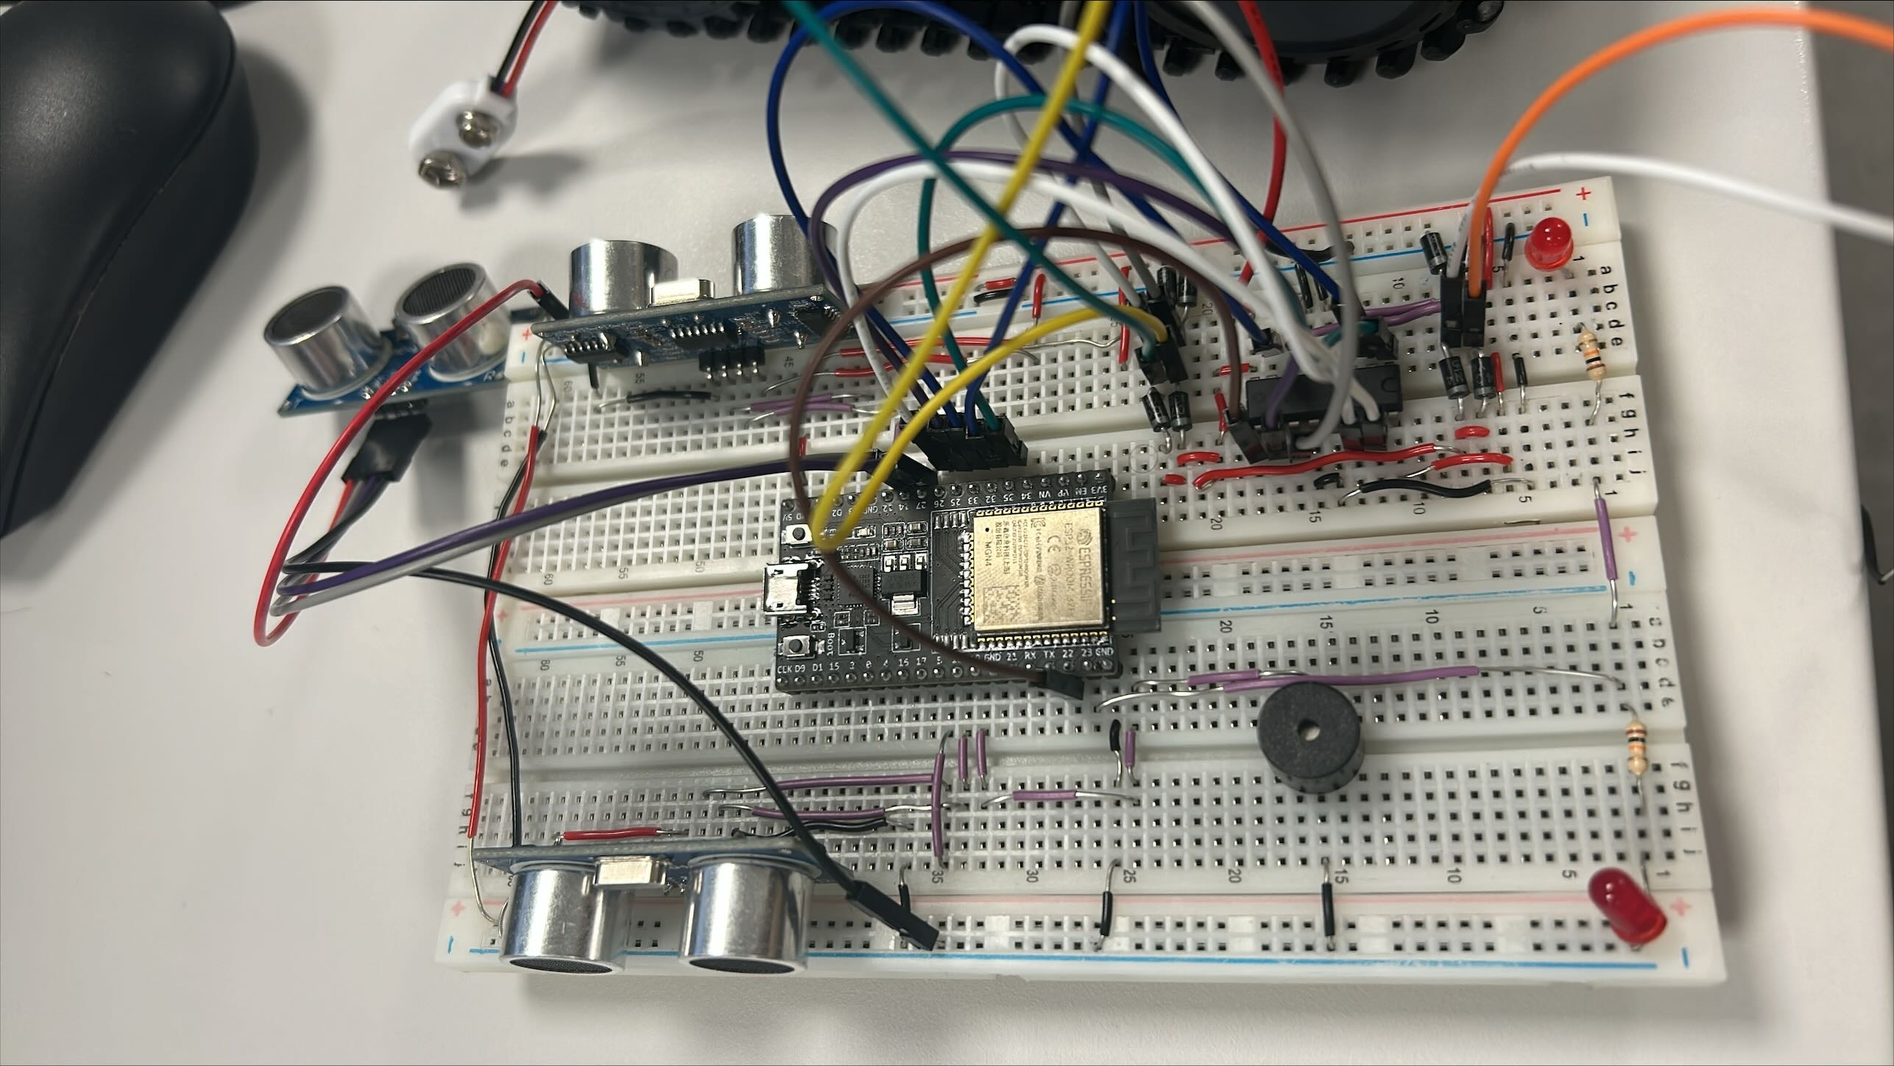
UltraNav
Denis Johnson
G00403126
BEng (Hons) Software & Electronic Engineering
Project Summary
What is UltraNav?
UltraNav is an intelligent RC vehicle powered by an ESP32-CAM module, designed for remote-controlled exploration with real-time feedback. It features:
Live Camera Feed – Stream high-quality video via a web interface or mobile app for first-person driving.
Obstacle Detection & Auto-Brake – An ultrasonic sensor ensures safety by detecting obstacles and stopping automatically.
Remote Control – Operate the vehicle through a user-friendly web app or mobile app with full directional control.
Alerts & Indicators – LEDs and a buzzer warn of nearby obstacles and can be manually triggered.
Real-Time Tracking – Monitor the vehicle’s location remotely for seamless navigation.
UltraNav combines smart automation, wireless control, and safety features for an enhanced remote driving experience!
Technologies Used
Hardware:
12V Battery: Powers the motors for movement, providing high torque and speed.
Driver Motor: Controls the direction and speed of the motors based on signals from the ESP32
Motor: Drive the wheels, enabling forward, reverse, and turning movements.
UltraSonic Sensor: Detects obstacles in the vehicle’s path and triggers auto-braking to prevent collisions.
Buzzer: Emits audible alerts when obstacles are detected or when manually activated via the app.
Camera:Streams real-time video to the web/mobile app and processes control commands.
LED: Provide visual warnings for obstacles and can be remotely controlled for added functionality.
Power Bank: Supplies stable 5V power to the ESP32-CAM for uninterrupted operation.
Software:
Mobile App: Allows remote control of the vehicle via smartphone and displays live camera feed.
Webpage: Accessible from any device with a browser and shows real-time video streaming.
Wi-Fi: Enables wireless communication between the vehicle, app, and webpage.
VsCode: A powerful, lightweight code editor for writing and debugging firmware.
Platform IO: Simplifies ESP32 programming with built-in libraries for Wi-Fi, camera, and sensors.
Conclusion
The process of creating UltraNav has been enjoyable! What started as a basic remote-controlled car kit grew into a creative online robot that I can control from my phone while watching its real-time video feed. When it detects impediments, it practically drives itself, the ultrasonic sensor has already prevented many accidents!
Hardware Design
The UltraNav's chassis was carefully selected as a prefabricated metal RC car frame, chosen for its durability and rigidity.
The assembly process involved mounting all components onto this sturdy base, ensuring proper weight distribution and structural integrity for smooth operation.
The dual-motor drivetrain consists of two high-torque DC gear motors securely mounted to the chassis. These motors connect to an L298N motor driver, allowing for precise PWM speed control and bidirectional movement.
Project Architecture
System Parts
Led
Buzzer
Powerbank
Camera
Webpage
Wi-Fi
Live Camera Feed
Led Control
Motor Control Sensor Alerts
Esp32
VsCode
Platform IO IDE
Runs Webpage and Mobile App
Powers System Parts
Car Parts
12V Battery
DC Motor
Motor Driver
Diode
Chassis
Mobile App
Bluetooth
Live Camera Feed
Led Control
Motor Control
Sensor Alerts

